Slide 1
Searching and Sorting
Problem Solving with Algorithms & Data Structures Using Python

Slide 2
Objectives
To be able to explain and implement sequential search and binary search
To be able to explain and implement selection sort, bubble sort, merge sort, quicksort, insertion sort, and Shell sort
To understand the idea of hashing as a search technique
To understand the map abstract data type
To implement the map abstract data type using hashing

Slide 3
Searching

Slide 4
Searching
Searching is the algorithmic process of finding a particular item in a collection of items
A search typically returns either True or False
May be modified to return where the item is found

Slide 5
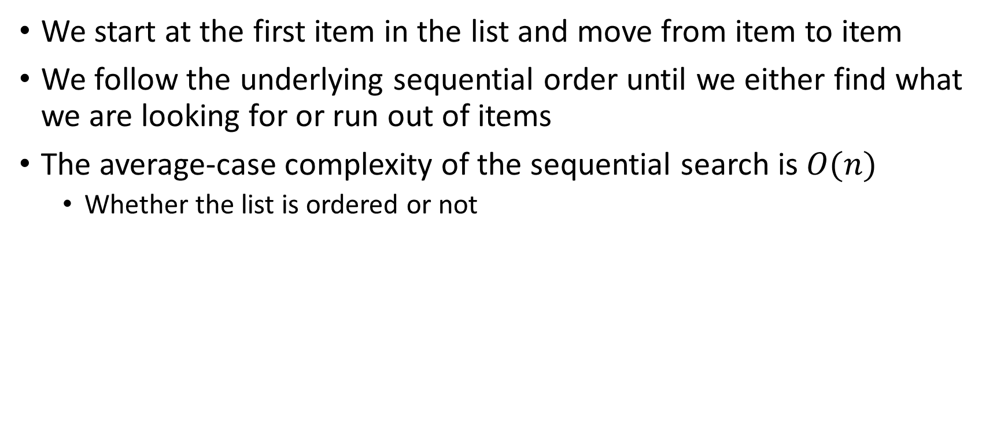
Sequential Search
We start at the first item in the list and move from item to item
We follow the underlying sequential order until we either find what we are looking for or run out of items
The average-case complexity of the sequential search is $O(n)$
Whether the list is ordered or not

Slide 6
Binary Search
It is possible to take greater advantage of the ordered list
Instead of searching the list in sequence, a binary search will start by examining the middle item
If that item is the one we are searching for, we are done
If the item we are searching for is greater than the middle item it must be in the second (right) half
The entire first (left) half of the list as well as the middle item can be eliminated from further consideration
If the item we are searching for is less than the middle item it must be in the first (left) half
The entire second (right) half of the list as well as the middle item can be eliminated from further consideration

Slide 7

Binary Search
Divide and conquer
The complexity is $O(\log{n)}$
Only works on ordered lists

Slide 8
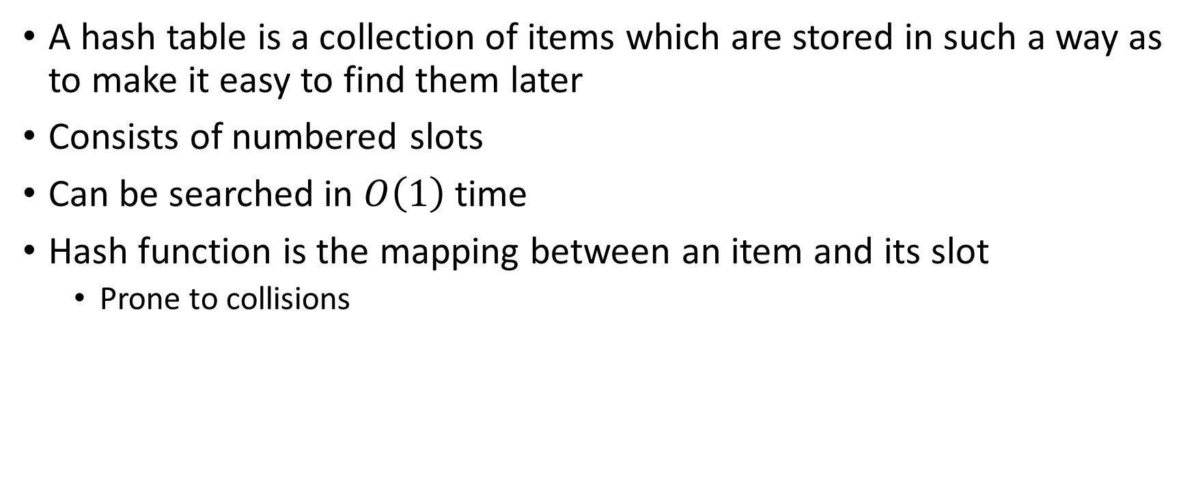
Hashing
A hash table is a collection of items which are stored in such a way as to make it easy to find them later
Consists of numbered slots
Can be searched in $O\left(1\right)$ time
Hash function is the mapping between an item and its slot
Prone to collisions

Slide 9
Hashing
A hash function that maps each item into a unique slot is referred to as a perfect hash function
Folding
Mid-square
Perfect hash functions are often either not possible or not practical
Collisions are unavoidable
Collision resolution is a very important part of hashing
Linear probing
Quadratic probing
Chaining

Slide 10
Map ADT
Map()
Creates a new empty map
put(key, val)
Adds a new key–value pair to the map
If the key is already in the map, it replaces the old value with the new value
get(key)
Takes a key and returns the matching value stored in the map or None otherwise
Del
Deletes the key–value pair from the map using a statement of the form del map[key]
size()
Returns the number of key–value pairs stored in the map
in
Returns True for a statement of the form key in map if the given key is in the map, False otherwise.

Slide 11

Analysis of Hashing
Best case
$O(1)$
Collisions
Load factor $λ$
As $λ$ grows, table fills up, number of collisions increases
Look up time increases

Slide 12
Sorting

Slide 13
Sorting
The process of placing elements from a collection in some kind of order
Alphabetical
Numerical
Comparison of algorithms
The total number of comparisons
The total number of exchanges

Slide 14
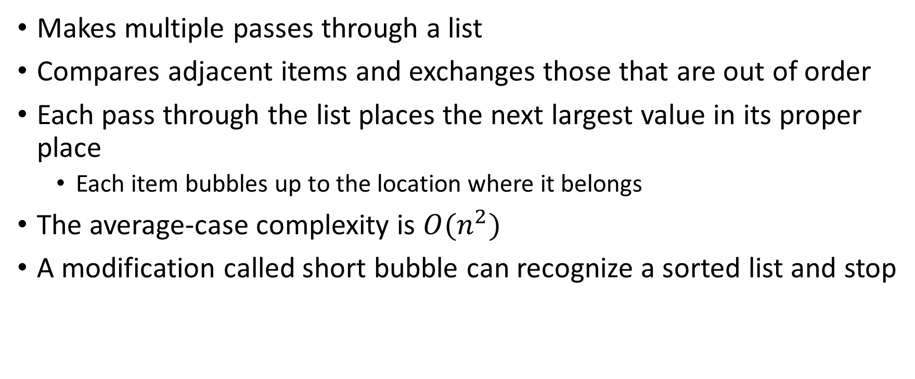
Bubble Sort
Makes multiple passes through a list
Compares adjacent items and exchanges those that are out of order
Each pass through the list places the next largest value in its proper place
Each item bubbles up to the location where it belongs
The average-case complexity is $O(n^{2})$
A modification called short bubble can recognize a sorted list and stop

Slide 15
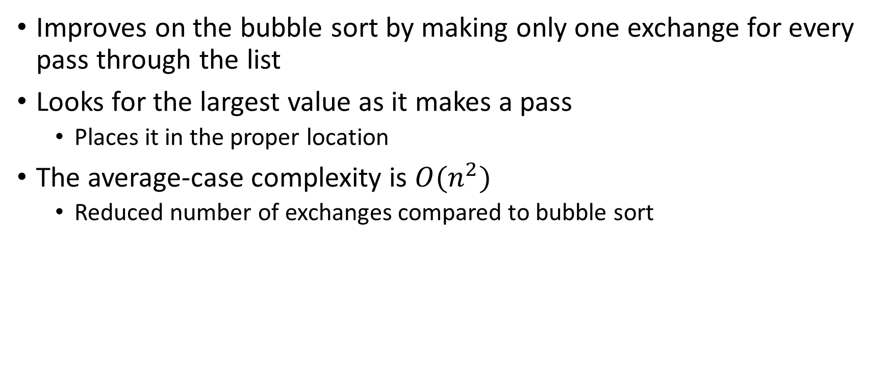
Selection Sort
Improves on the bubble sort by making only one exchange for every pass through the list
Looks for the largest value as it makes a pass
Places it in the proper location
The average-case complexity is $O(n^{2})$
Reduced number of exchanges compared to bubble sort

Slide 16
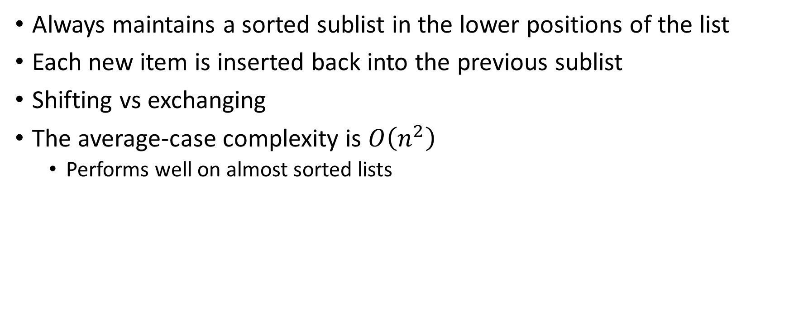
Insertion Sort
Always maintains a sorted sublist in the lower positions of the list
Each new item is inserted back into the previous sublist
Shifting vs exchanging
The average-case complexity is $O\left(n^{2}\right)$
Performs well on almost sorted lists

Slide 17
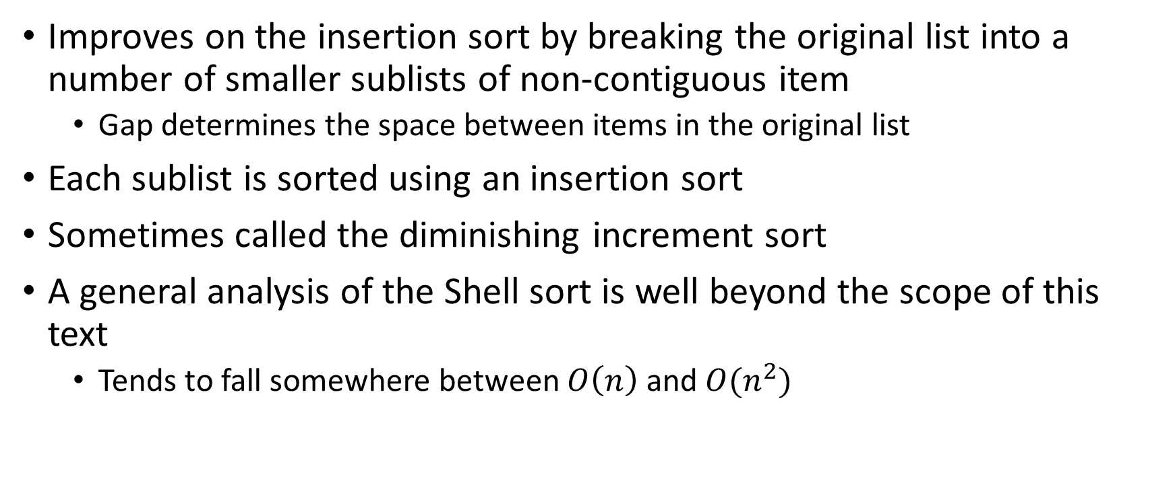
Shell Sort
Improves on the insertion sort by breaking the original list into a number of smaller sublists of non-contiguous item
Gap determines the space between items in the original list
Each sublist is sorted using an insertion sort
Sometimes called the diminishing increment sort
A general analysis of the Shell sort is well beyond the scope of this text
Tends to fall somewhere between $O\left(n\right)$ and $O(n^{2})$

Slide 18
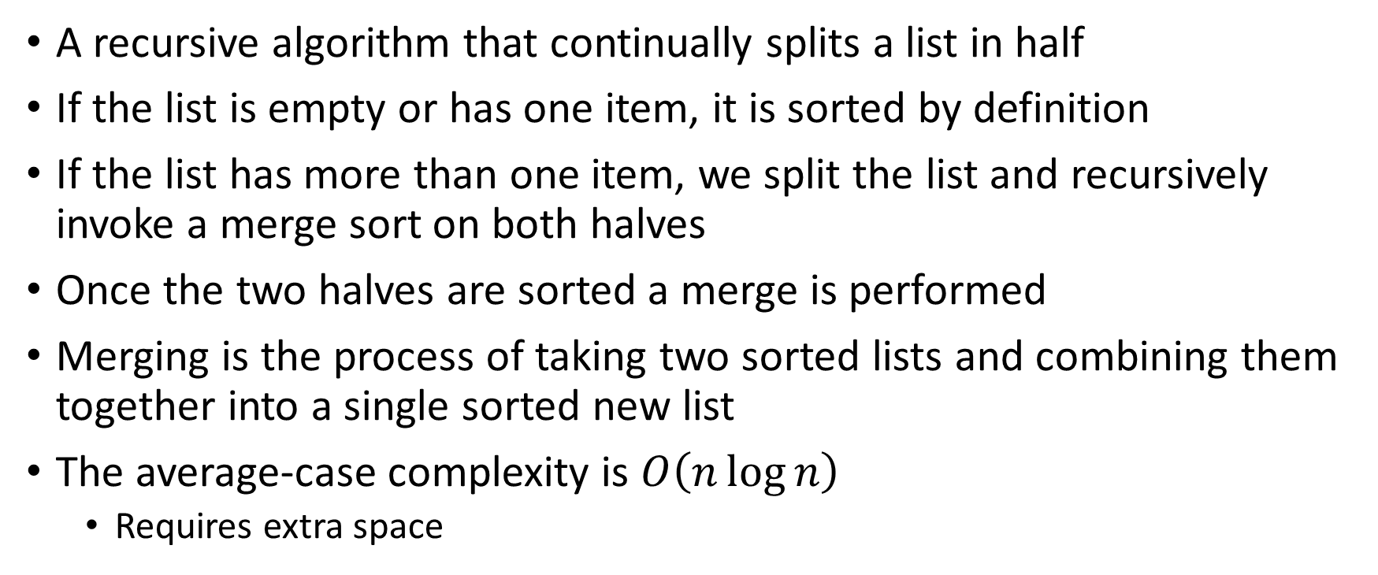
Merge Sort
A recursive algorithm that continually splits a list in half
If the list is empty or has one item, it is sorted by definition
If the list has more than one item, we split the list and recursively invoke a merge sort on both halves
Once the two halves are sorted a merge is performed
Merging is the process of taking two sorted lists and combining them together into a single sorted new list
The average-case complexity is $O\left(n\log{n}\right)$
Requires extra space

Slide 19
Quicksort
Uses divide and conquer while not using additional storage
It is possible that the list may not be divided in half
When this happens, performance degrades
First, select a pivot value
First item
Middle item
Median of three
Next, perform the partitioning
Move the pivot in its place (split point)

Slide 20

Quicksort
The average-case complexity is $O\left(n\log{n}\right)$
The worst-case complexity is $O\left(n^{2}\right)$
With the overhead of recursion

Slide 21
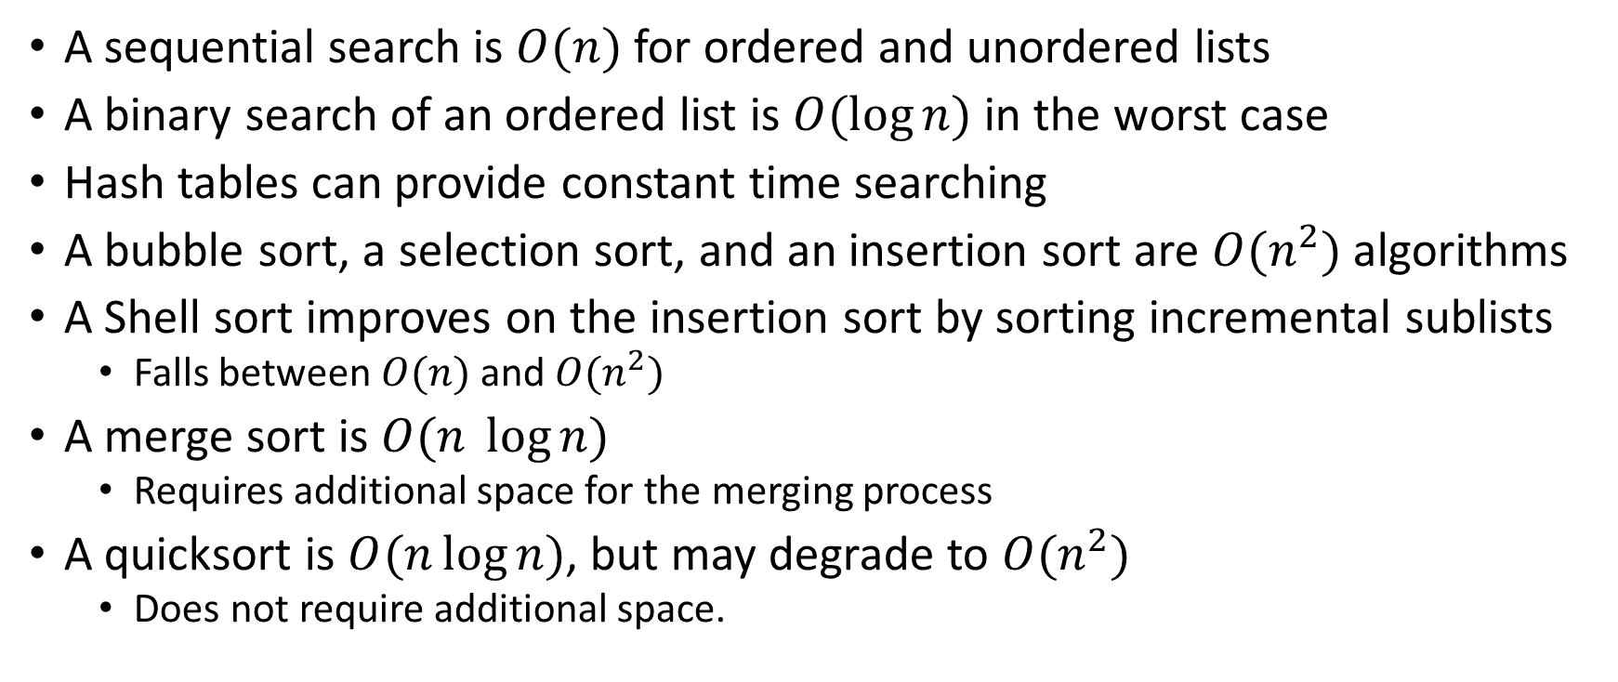
Summary
A sequential search is $O(n)$ for ordered and unordered lists
A binary search of an ordered list is $O(\log{n})$ in the worst case
Hash tables can provide constant time searching
A bubble sort, a selection sort, and an insertion sort are $O(n^{2})$ algorithms
A Shell sort improves on the insertion sort by sorting incremental sublists
Falls between $O(n)$ and $O(n^{2})$
A merge sort is $O(n \log{n)}$
Requires additional space for the merging process
A quicksort is $O(n\log{n)}$, but may degrade to $O(n^{2})$
Does not require additional space.

